Slide 1

Kilburn Infant and Nursery School
Local Information Report 2025

Slide 2
What kind of Special Educational Needs provision is made at the school?
What expertise and training do staff have in relation to pupils with SEND?
How are children with SEND identified and assessed?
How will the school support and prepare a child with SEND to transfer to a new setting?
Who should I contact regarding SEND?
What support is there for a child’s social and emotional development?
How will I know how my child is doing and how can I support them?
How accessible is the school, both indoors and outdoors?
How does the school evaluate the effectiveness of its provision for pupils with SEND?
How do school consult with children about SEND?
How will the school staff support my child?
How are parents/carers involved in the school?
How does the school decide on the amount and type of support a child will receive?
What is the Derbyshire Local Offer?
Which other agencies might support a child with SEND?
How does the school adapt the curriculum and learning environment for pupils with SEND?
Who shall I contact if I have concerns about the provision being provided?
Is there any support for parents/carers of pupils with SEND?

Slide 3
What kind of Special Educational Needs and Disabilities (SEND) provision is made at the school?
Kilburn Infant and Nursery School is a small, fully inclusive mainstream school.
At Kilburn Infant and Nursery School we are committed to the equality of opportunity and the provision of the highest standard of education for all our pupils, including those with Special Educational Needs and disabilities.
At Kilburn Infant and Nursery School we are committed to the equality of opportunity and the provision of the highest standard of education for all our pupils.

Slide 4
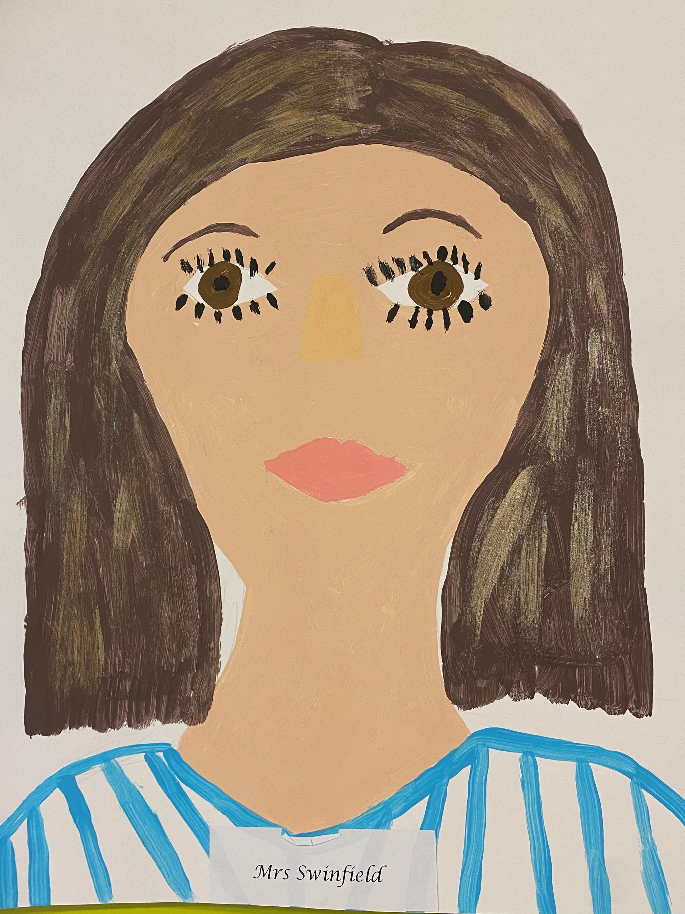
Who should I contact regarding SEND?
The Head teacher is Mrs Joanne Baillie.
The Inclusion Leader is Mrs Louise Swinfield.
The SEND Governor is currently Mr Shaun Kearney.
Mrs Swinfield can be contacted directly on 01332 880449 or at louises65@kilburn-inf.derbyshire.sch.uk

Slide 5
How are children with SEND identified and assessed?
When your child starts school, we will assess them using a variety of assessments and observations, including liaising closely with pre-schools, previous settings and parents/carers.
Pupils who may have Special Educational Needs and Disabilities can be identified in a number of ways. The use of school’s data tracking identifies pupils who are not making expected progress or are not on track to achieve their end of level target.
Concerns voiced by parents/carers, a member of staff, an external professional or the child themselves. Pupils may come to us with outside agencies already involved.

Slide 6
How are children with SEND identified and assessed continued…?
Kilburn Infant and Nursery School has links with outside agencies including but not limited to Paediatricians, Educational Psychology, Inclusion Support Advisory Service, Early Years SEN Service, Speech Therapy and Support Services for children with physical, visual and sensory impairments.
The Inclusion Leader makes referrals to these outside agencies as needed.
Progress of children with SEND is carefully monitored by scrutiny of data tracking grids and intervention monitoring. Children tracking below expected levels or making less than expected progress are identified and interventions are put in place.

Slide 7
How does the school evaluate the effectiveness of its provision for pupils with SEND?
Governors are involved in this process and regular meetings take place to look at provision and pupil groups.
All pupils who access an intervention are monitored closely and entry and exit data is used. The increase in attainment is analysed to ascertain whether the progress made on the intervention is below expected, expected or better than expected.
Provision mapping by class teachers is done alongside the Inclusion Leader and overseen by the Head teacher to ensure that all teachers provide a relevant and enriching curriculum for pupils of all abilities and developmental stages.

Slide 8
How will I know how my child is doing and how can I support them?
Assessments are carried out each term to analyse the level that each pupil is attaining. Termly Pupil Progress Review Meetings look in detail at the progress made in all areas by pupils with SEND. Where relevant, children with SEN in Early Years will be tracked using the Celebratory Checkpoints and those in key Stage One, the Formative Footprints or the Engagement Model.
Parents/carers are involved in the review process at least 3 times a year at review meetings when a teacher will go through the targets on the SEN support plan and at pupil achievement meetings which take place three times per year. Ways in which parents/carers can help at home are discussed and form part of the SEN support plan. Teachers/Inclusion Leader may hold workshops to work with parents/carers and help them to support their child during the year.
At the end of each academic year a written report is sent to parents/carers detailing progress.
The Inclusion Leader and class teacher are available for appointments to discuss progress at any other time during the year.
Regular contact is through home/school diaries or individual pupil diaries if more appropriate. Staff also have face to face contact every day with parents/carers.

Slide 9
How will the school staff support my child?
All pupils on the SEND register have a one page profile and an SEN support plan which details their next targets and strategies undertaken to accelerate progress towards these.
All pupils with SEND receive high quality adaptive teaching: adaptive teaching strategies within the classroom and personalised resources where required.

Slide 10
How does the school adapt the curriculum and learning environment for pupils with SEND?
Our curriculum is broad, balanced and relevant to a changing society. Our pupils are actively engaged in their learning. We aim to ensure all pupils, including those with special educational needs and disabilities, have full curriculum entitlement and access.
We aim to provide work that is matched and therefore accessible to the broad range of pupils we teach. The in-class support provided by teaching assistants, the Inclusion Advisory Support Service and other agencies is carefully considered by each class teacher when planning, in order to ensure all pupils with Special Educational Needs and Disabilities continue to receive a broad and balanced curriculum.
If pupils are withdrawn in order to meet their Special Educational Needs, the class teacher will ensure that this does not affect the pupil’s access to the full range of curriculum activities.
Adaptive teaching will be provided in a range of ways, depending upon which is most appropriate, and will include but is not limited to; simplifying or chunking of tasks, by ability groupings, by the level of adult support, by the level of expectation, by the allocation of appropriate resources or by outcome.
Our Accessibility Plan details improvements to be made and standards to be maintained to ensure quality of access.

Slide 11
How does the school decide on the amount and type of support a child will receive?
The school receives funding for pupils with Special Educational Needs and Disabilities through the Local Authority. This funding is to support work with pupils with an EHCP and pupils without. The allocation is made following needs analysis discussions between the senior management team. The funding is used to purchase classroom support, buy services in to give advice and also resources.
Early Years Inclusion Funding is available via application for children in Nursery.
As part of the Graduated Response for individual pupils, applications may be made for additional funding to provide support for those children with more complex needs and those with needs that cannot be fully met from usually available resources. Parents/carers will always be involved in the decision making process before an application goes ahead and decisions reviewed with the Inclusion Leader when formally received. This is referred to as Inclusion Panel Funding.

Slide 12
How does the school decide on the amount and type of support a child will receive continued…?
The school will request an Education, Health and Care Needs Assessment from the Local Authority when, despite an individualised programme of sustained intervention and SEN support the pupil remains a significant cause for concern. An Education, Health and Care Needs Assessment might also be requested by a parent/carer.
An EHCP will normally be provided where, after an assessment, the LA considers the pupil requires provision beyond what the school can offer. However, the school recognises that a request for assessment does not inevitably lead to a plan.

Slide 13
What support is there for a child’s social and emotional development?
We have robust behaviour and anti-bullying policies in place that are reviewed regularly.
Pupils’ emotional health and well-being is paramount. We recognise that pupils with SEND may well have emotional and social development needs that will require support in school. All staff continually monitor the emotional health and well-being of all our pupils.
All classes follow the Derbyshire PSHE scheme of work and in addition to this, children are taught coping strategies, breathing techniques and take part in class yoga sessions twice a week. Every classroom has calm areas and calming resources.
Nursery use The Colour Monster text to explore and support their work on feelings and the rest of the school use the Zones of Regulation. This can also be used as an intervention for small groups or individuals. We also use ‘What Am I Feeling’?
Social Stories is a short term intervention strategy for individuals or groups, supported by TA’s to address barriers to learning arising from social, emotional and behavioural difficulties.
Circle of Friends activities encourage children to build positive relationships and working partnerships.
Pupils may work on a one to one basis with an adult to address needs specific to that pupil, in order to raise self-esteem.

Slide 14
What support is there for a child’s social and emotional development continued…?
The Time to Talk programme is available across school to teach, promote and develop oral language and social interaction skills.
Each class, once every half term uses a text to base their learning around that supports/focuses on positive mental health and wellbeing. These can be found on our English overviews.
We use the Anxiety/Anger Gremlin programmes with individual children.
Referrals can be made to Compass – changing lives.
Medicines and Health, pupils with medical needs may be provided with a Health Care Plan, compiled in partnership with the School Nurse and parents/carers or agreed by the parents/carers and school staff and if appropriate, the pupil themselves. Additional training is undertaken by key staff as and when necessary.
Personal care is conducted discreetly, with dignity and fostering independence where possible.
At Kilburn Infant and Nursery School attendance is high. The attendance of our SEND pupils is monitored monthly buy the Head Teacher.

Slide 15
What expertise and training do staff have in relation to pupils with SEND?
Mrs Swinfield has worked at KINS for 23 years and is a very experienced Inclusion Leader.
The Inclusion Leader supports class teachers in planning for pupils with SEND.
All of the teachers at Kilburn Infant and Nursery School are qualified and a number of them have received specialist further professional development in a number of areas linked to Special Educational Needs including Autism, Attachment and Developmental Trauma.
Our whole school has done Level 1 Makaton training and this is used across school by staff and children. The whole staff have also been trained in using the Zones of Regulation, Emotion Coaching, ADHD, Sensory Processing and Autism.
The Inclusion Leader undertakes regular training and cascades this information to all staff across school. This has included Autism in girls, Autism, Dyslexia and Memory Matters.

Slide 16
What expertise and training do staff have in relation to pupils with SEND continued…?
The school provides training and support to enable all staff to improve teaching and learning of pupils, including those with Special Educational Needs and Disabilities.
Our Teaching Assistants also have a range of expertise in a variety of specialised areas including Autism, Dyslexia, ADHD, Makaton/Sign Language, Physical Literacy, Speech and Language and Hearing Impairment. The staff in our Early Years Team are Early Talk Boost trained.A number of TA’s across school have been trained in delivering precision teaching, Attention Autism, Lego Therapy and Circle of Friends, and all TA’s have accessed Makaton Level 1, Attachment, Autism training, Attention Autism, Emotion Coaching and Zones of Regulation training in the past two years.
The school accesses a variety of services to ensure that the skills of the staff match the needs of the current pupils and plans ahead to ensure the needs of future pupils can be accommodated.

Slide 17
How accessible is the school, both indoors and outdoors?
Kilburn Infant and Nursery School is a multi-site school with all single storey buildings which are accessible to all. Adaptations to classrooms, carpets, curtains and projectors are made, when appropriate, and parents/carers are invited to share accessibility concerns so that advice can be obtained from relevant professionals. There are quiet areas/rooms for working and cosy areas for children who are overwhelmed. Suitable equipment includes wobble cushions, sloping boards, chew buddies, fiddles, talking tins, pencil grippers, triangular pencils/crayons, adapted scissors, calm baskets and chill out tents. In one of our classrooms in the main school building we have created a ‘Nurture Nest’ including a sensory area which can be used by any children across school.
There is a disabled toilet with changing facilities available in Nursery and a disabled toilet in the Main School Building.
The equipment used in school is accessible to all pupils regardless of needs.
For further details please see the Accessibility Plan.
All extra-curricular activities are available to all children and will be suitably differentiated and supported to ensure access to all.
Support from MDS or a TA will be available at playtime and lunchtime each day to support pupils who may find these times difficult.
All educational visits are open to all pupils. Adult support and resources are made available to ensure that all pupils can access these activities. The teacher, Inclusion Leader and/or Head Teacher works closely with parents/carers before a trip to discuss specific needs of the pupil, where relevant. As part of the risk assessment, we may ask for a parent/carer to accompany us on a school visit.

Slide 18
How are parents/carers involved in school?
The school aims to work in partnership with parents and carers. We do so by:
Keeping parents and carers informed and giving support during assessment and any related decision-making process about SEND provision
Working effectively with all other agencies supporting children and their parents/carers.
Giving parents and carers opportunities to play an active and valued role in their child’s education – gathering parent/carer views on their child’s needs termly, meeting termly in the form of SEN support plan meetings and pupil achievement meetings three times a year.
Making parents and carers feel welcome
Termly information sessions with the Inclusion Leader and when available, other agencies
Ensuring all parents and carers have appropriate communication aids and access arrangements
Direct contact with the Inclusion Leader via phone or email
Providing all information in an accessible way

Slide 19
How are parents/carers involved in school continued…?
The school aims to work in partnership with parents and carers. We do so by:
Encouraging parents and carers to inform school of any difficulties they perceive their child may be having or other needs the child may have which need addressing
Instilling confidence that the school will listen and act appropriately
Focusing on the child’s strengths as well as areas of additional need
Allowing parents and carers opportunities to discuss ways in which they and the school can help their child
Agreeing targets for the child
Making parents and carers aware of the Derbyshire Information, Advice and Support Service for SEND and any other support services they could access
Directing parents/carers to the Derbyshire Local Offer to raise awareness of support available
Signposting parents/carers to out of school activities and groups that are specifically for SEN children and their families

Slide 20
How do school consult with children about SEND?
We recognise that all pupils have the right to be involved in making decisions and exercising choice (SEN Code of Practice 2014). Where appropriate all pupils are involved in monitoring and reviewing their progress. We endeavour to fully involve all pupils by encouraging them to:
State their views about their education and learning through a one-page profile
Identify their own needs through a one-page profile
Share in individual target setting across the curriculum
Self-review their progress and set new targets
In addition, if it is deemed appropriate, pupils who are identified as having SEND are invited to participate in:
Contributing to targets for their SEN support plans
Working with adults in small groups and one-to-one sessions
Person centred reviews
Pupil voice

Slide 21
Who shall I contact if I have concerns about the provision being provided?
In the first instance we encourage parents to contact their child’s class teacher as they know your child best and spend time with them every day.
If concerns remain, we ask parents to contact the Inclusion Leader and/or Head teacher through school.
In the unlikely event that a concern is not resolved, parents/carers are asked to contact the SEND Governor (Mr Kearney) or the Chair of Governors (Mrs Boyd).

Slide 22
Which other agencies might support a child with SEND?
At Kilburn Infant and Nursery School we may receive support from
Educational Psychology Service
Inclusion Support Advisory Team (New since September 2024)
Early Years SEN service
Support Service for visual, physical and hearing impairments
Speech and Language Therapy (SALT)
Physiotherapy Service
Occupational Therapy Service
Community Paediatrics
Clinical Paediatrics
Child and Adolescent Mental Health Services (CAMHS)
Virtual Schools (Derby/Derbyshire)

Slide 23
How will the school support and prepare a child with SEND to transfer to a new setting?
We recognise that transition can be difficult for a child with SEND.
If your child is moving to another school, we will contact the school and ensure that they know about any special arrangements or support that needs to be in place for your child. We will meet with staff beforehand. We will make sure all records are passed on.
We will support your child during visits to their new school wherever possible and if required one of our TA’s will accompany the child during their visits.
When moving classes in school, information will be passed onto the new class teacher in advance and a meeting will take place between the current and new class teachers and TA’s. Staff from the new year group will visit your child in their current year group and they will have the opportunity to visit their new class and meet their new teacher. Some pupils will benefit from a passport to take home with them over the summer.

Slide 24
How will the school support and prepare a child with SEND to transfer to Kilburn Junior School?
There is a detailed transition plan in place. A transition meeting at both schools will take place.
The Year Two and Three teachers meet to discuss all children who will be transferring. The Inclusion Leader also meets regularly with the SENDCo at Kilburn Junior School to discuss those children who are transferring and who have SEND.
The Year Two children have many opportunities to meet with the staff and the children from KJS beginning with visits taking place at KINS. If your child has SEND or we feel they would benefit from additional visits, these are arranged. We will also provide a transition book for your child to take home during the summer. All school records are transferred between the Head teachers to ensure that new staff are as informed as possible about a child’s special educational needs and disabilities.

Slide 25
Is there any support for parents/carers of pupils with SEND?
Your child’s class teacher and the Inclusion Leader are always available to discuss your child’s needs and progress. The Inclusion Leader can be contacted via email or phone and will support parents/carers with filling in forms, making phone calls, visiting schools etc.
Parents/Carers are regularly signposted to relevant services by the Inclusion leader and provided with information on how to support their child at home. We also hold a termly training session for parents/carers which includes refreshments and the chance to connect with other families.
All outside agencies will contact parents/carers to keep them informed of their involvement.
Derbyshire Information Advice and Support Service for special educational needs and disabilities
DIASS offer support for children and young people with SEND from birth to 25 years old. They aim to help parents and carers increase their involvement in the education of their children and ensure that they have access to information and advice about issues relating to the child or young person's health and social care.
https://www.derbyshireiass.co.uk/home.aspx

Slide 26
Is there any support for parents/carers of pupils with SEND continued…?
DIASS special educational needs and disabilities advice line
Telephone: 01629 533668 Monday to Friday from 9:30am to 3pm.
DIASS general enquiries
Email: ias.service@derbyshire.gov.uk
Telephone: 01629 533660
Web address – https://www.derbyshireiass.co.uk/home.aspx
Derby and Derbyshire Emotional health and Wellbeing
https://derbyandderbyshireemotionalhealthandwellbeing.uk/
Compass – changing lives
Provides prevention and early intervention emotional wellbeing and mental health support to Children, Young People and Families (CYPFs) across Derby & Derbyshire.

Slide 27
Is there any support for parents/carers of pupils with SEND continued…?
Autism East Midlands Family Support Hub based in Heanor

Slide 28
What is the Derbyshire Local Offer?
https://www.localoffer.derbyshire.gov.uk/home.aspx
The Local Offer includes leisure and activity providers, health and care services, education providers and support groups. The Local Offer simply aims to pull information about available services into one place and make it clear and accessible for you and your family.
This utilises the Local Authority offer to meet the needs of SEND pupils as determined by school policy and the provision that the school is able to provide.

Slide 29
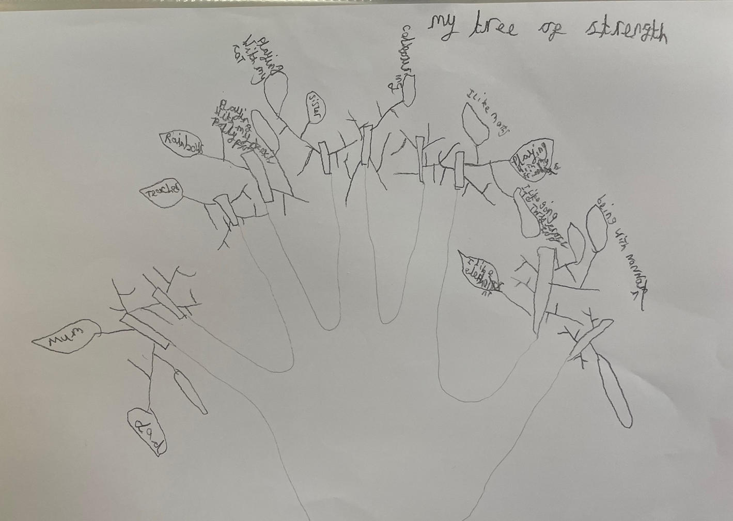
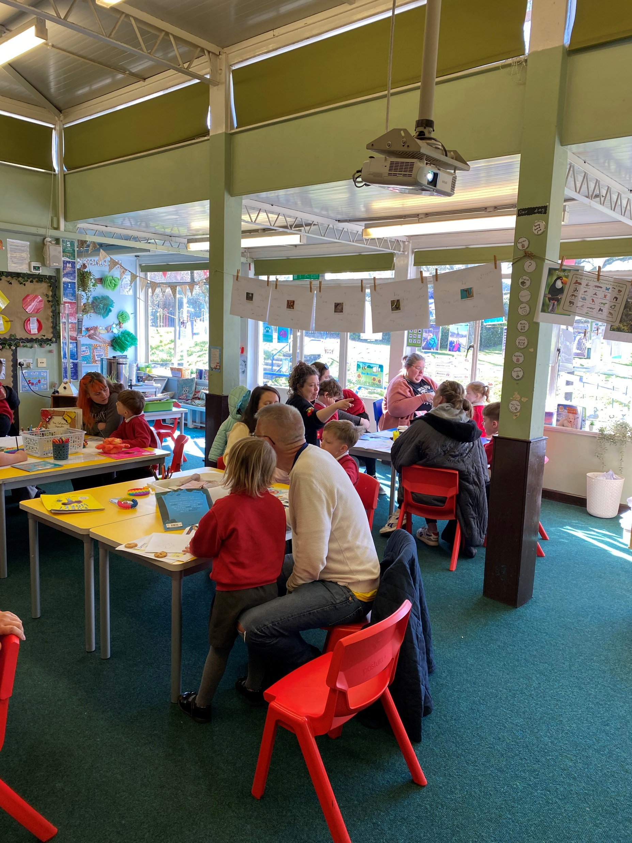
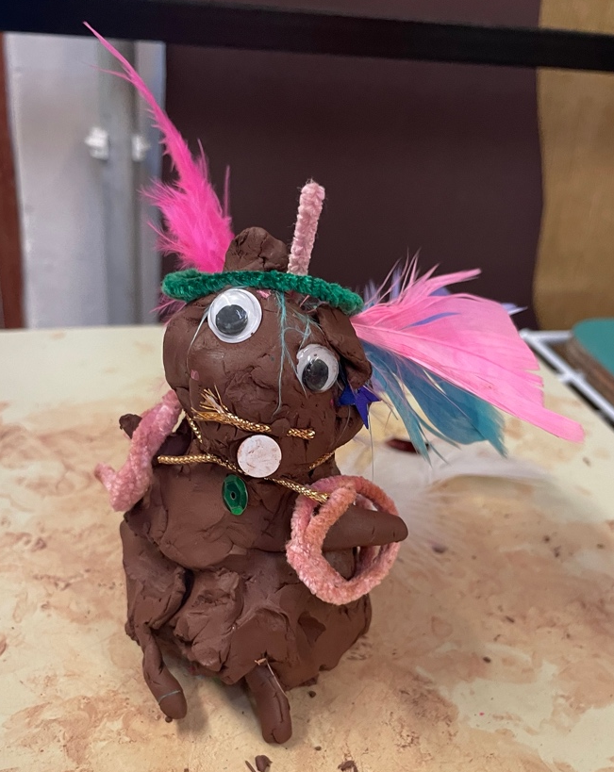
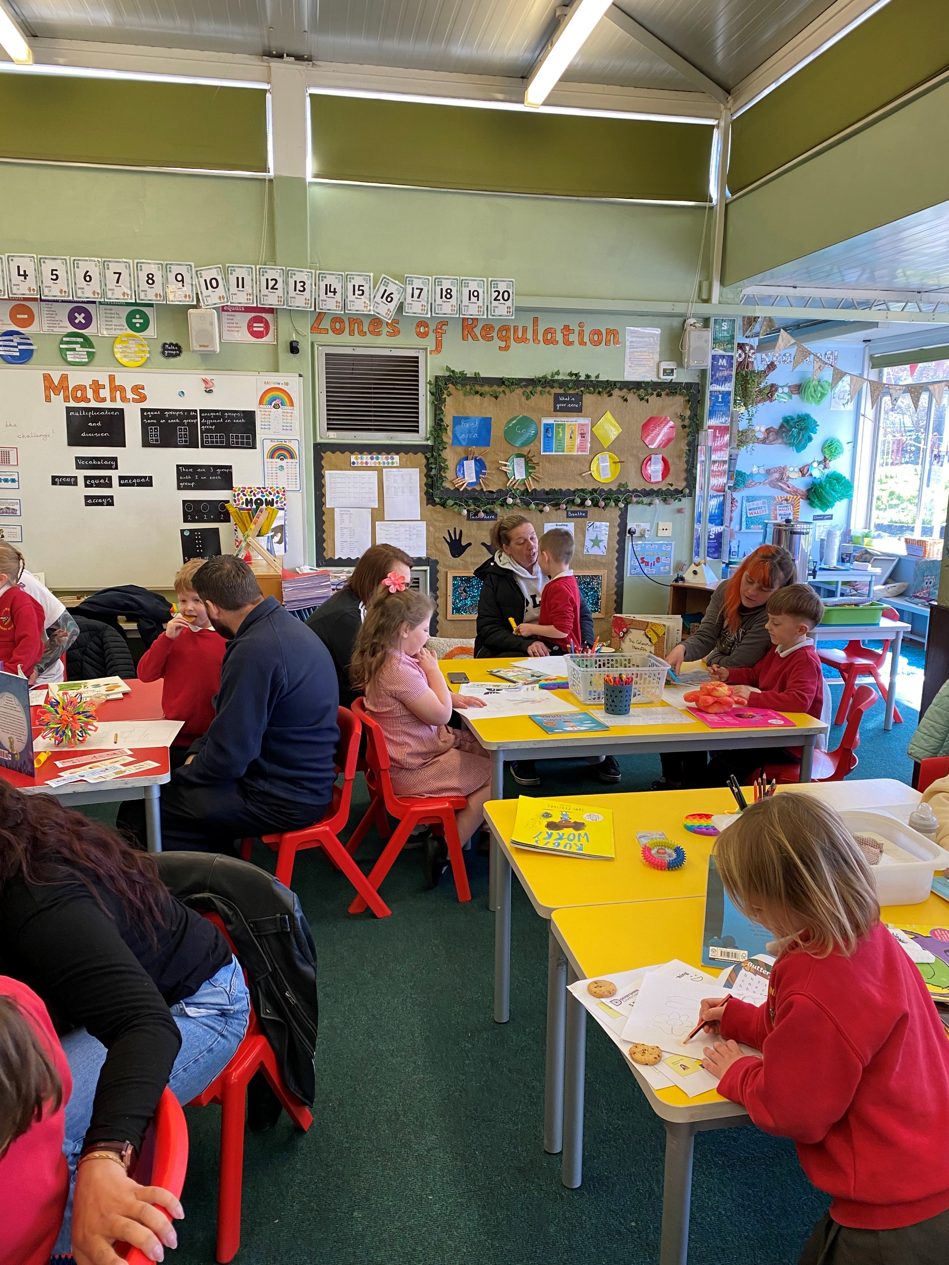
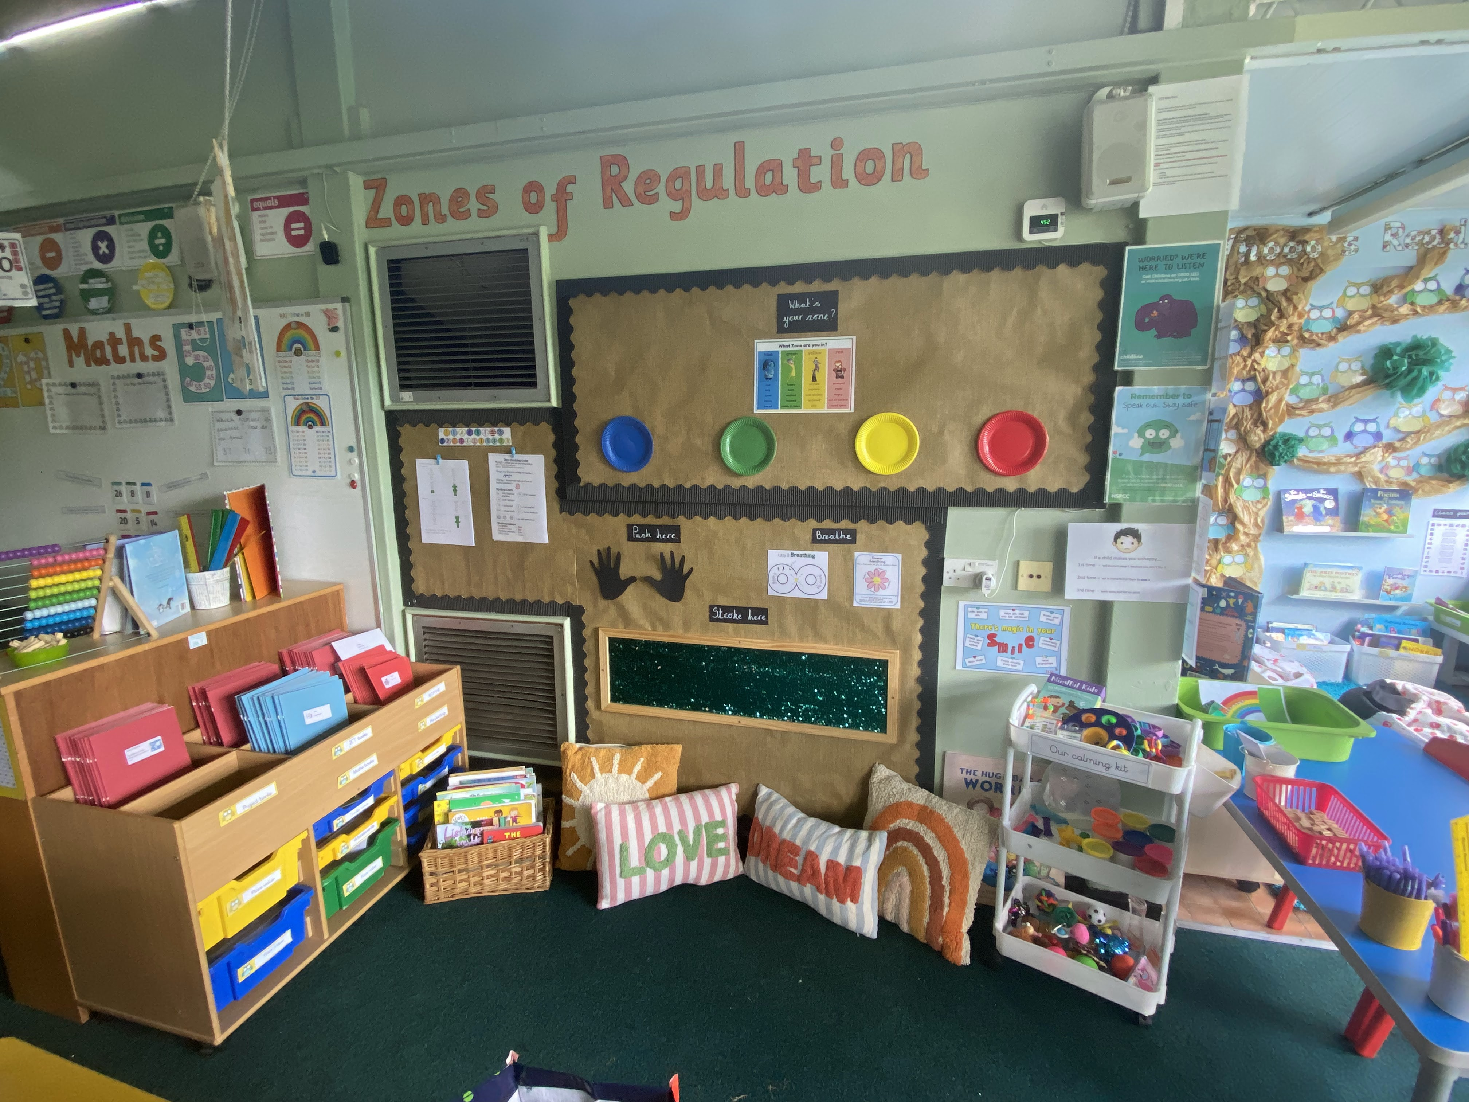
Photo gallery

