Slide 1


Welcome to Nursery
Getting ready for Autumn 2026
You'll be joining our Super Squirrels class!
Mrs S. Haselgrove • Nursery Teacher
A meeting for new parents and carers

Slide 2






THIS EVENING
What we'll cover
01
Our approach & the EYFS curriculum
02
A typical nursery day
03
Uniform, Sports kit & Forest Friday
04
Learning journeys & wow moments
05
Snacks, lunches & staying in touch
06
Settling in — and support for home
2

Slide 3
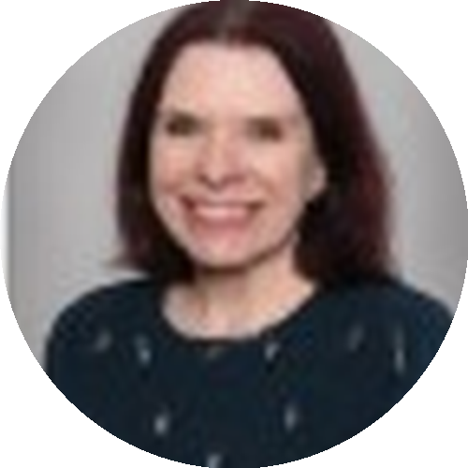
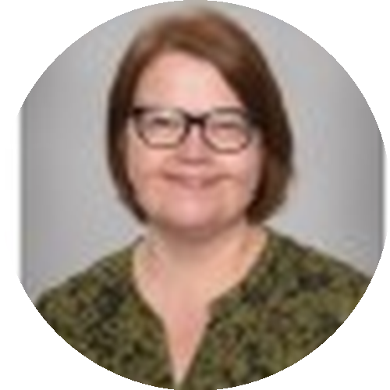
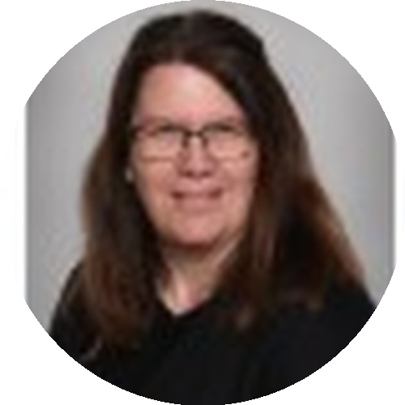
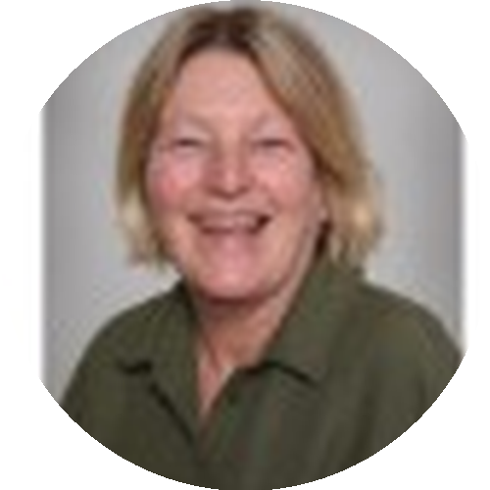
YOUR NURSERY TEAM
Meet the grown-ups
Mrs S. Haselgrove
Mrs R. Abberley
Mrs H. Parkin
Mrs J. Morrell
Nursery Teacher
Teaching Assistant
Teaching Assistant
Nursery Administrator/supply TA
Your child will also be given a key worker, who will get to know them well and update you on their progress.
3

Slide 4
OUR APPROACH
Not a tall tower — a strong foundation
In Nursery, we're not trying to build higher...
We're trying to build stronger.
This is what Nursery needs to build on: not rushed learning, but secure foundations.
...but without strong foundations, it won't last.
We're building stronger, not higher.
A tall tower might look impressive...
4

Slide 5
OUR APPROACH, CONTINUED
A solid wall is built slowly
Communication & Language
PSED
Physical Development
Play
Confidence
Resilience
Relationships
Routines
Phase 1 Phonics
Early Maths
Every one of these areas gets daily attention in Nursery — through play, stories, songs and real relationships. It's the groundwork that lets your child thrive once the more formal side of school learning begins.
5

Slide 6











THE EYFS FRAMEWORK
The curriculum: Prime Areas
Development Matters, Birth to Three — the three areas that underpin everything else
Communication
& Language
Personal, Social &
Emotional Development
Physical
Development
Listening & responding to familiar voices and instructions
Feeling safe and settled with a key person
Building whole-body control and coordination
Copying sounds, words and gestures
Expressing preferences and growing independence
Developing independence — dressing, feeding, toileting
Building vocabulary through songs, stories and talk
Learning to manage feelings and transitions
Exploring materials and tools safely
6

Slide 7
SESSIONS & TIMINGS
A typical nursery day
9.00am
Gate opens — morning session begins
Please say goodbye at the gate; staff will bring children safely inside.
12.00pm
Morning session ends
Children leaving at lunchtime are collected from the gate.
12.30pm
Afternoon session begins
3.00pm
Afternoon session ends
Children are collected from the Nursery playground.
Running late? Please ring the school office — 01332 880449
7

Slide 8









GETTING READY
Uniform & what to bring
Uniform
Outdoor & spare kit
Red sweatshirt or cardigan
Weather kit: sun hat & sun cream (applied at home) or winter hat, gloves & warm coat
Grey/black trousers, shorts or skirt
Rucksack with a full spare change of clothes — we do get messy!
Grey/black dress (red & white summer dress)
Red polo shirt or white school shirt
A labelled water bottle, filled with water, brought in daily
Shoes your child can manage themselves — slip-on or velcro is ideal
Please label everything — jumpers, cardigans, shoes and bottles especially
No jewellery, please, for safety
8

Slide 9



WEEKLY HIGHLIGHTS
Forest Friday & Sports Thursday
Forest Friday
Sports Thursday
Held every Friday morning in the Junior school's woodland area.
A sports session in the hall, led by our sports teacher, Mr Cooper.
Waterproof trousers & wellies — every week, whatever the weather
Joggers or leggings on Thursdays
A bag with sun hat/winter hat, gloves & waterproof coat
Trainers rather than school shoes
Sun cream applied at home on sunny days
Easy to move and get active in!
9

Slide 10

WATCHING THEM GROW
Learning journeys
We record your child's learning every day using 'Evidence Me' — photos and notes linked to their learning, sent to you by email several times a week.
Comment back
Parents' evenings
Book bags
Add your own thoughts in the parent section — we love hearing from you.
Held termly, for a longer conversation about progress.
Issued in week two — swap books every Thursday.
10

Slide 11


CELEBRATING SUCCESS
From busy bee to happy flower
Our behaviour approach
Wow moments
Every child begins the day on our 'brilliant bee'. Great choices — sharing, kindness, tidying away — move them up to our 'happy flower', earning a special sticker at the end of the day.
Big achievements, in Nursery or at home, get celebrated with a 'wow moment' — plus a choice from the treat box! Send us your own wow moments from home too, for example a swimming achievement or getting dressed independently.
It helps you see, at a glance, how your child's day has gone.
11

Slide 12



A LITTLE EXTRA FUN
Our travelling animals
We have 3 cuddly travelling animals who love adventures! If your child is chosen, they take the animal home for the weekend and bring it back at the start of the following week.
Monkey
Zebra
Leopard
We'd love you to write a little diary of the adventures — and take photos, if you'd like! Have fun together.
12

Slide 13

FOOD & DRINK
Snacks & packed lunches
Snack time
Packed lunches
Please bring a water bottle filled only with water, brought in daily. Water, milk, fruit and a carbohydrate snack (breadstick, crackers, malt loaf or biscuits) are available for children to help themselves to.
If your child is staying all day, please provide a labelled lunch box. Place it, along with their water bottle, on the trolley as they arrive in Nursery each morning.
Voluntary contribution: 50p per week, or paid termly (£2.50–£3.50 depending on the half term).
13

Slide 14



COMMUNICATION
Staying in touch
ParentHub
All newsletters and important messages are sent via the ParentHub app. Let staff know if you have any trouble logging in.
Website
Our school website has further information about the school and your child's curriculum.
Label everything
Our Nursery is large and things go missing easily — names on jumpers, cardigans, shoes and bottles help enormously.
14

Slide 15
Settling in
We hope your child settles in quickly and goes home with a smile every day.
Your child's key worker will work closely with them and keep you updated on their progress.
Please come and see us any time you have a question — or email enquiries@kilburn-inf.derbyshire.sch.uk
15

Slide 16


SUPPORT FOR HOME
Extra help — potty training
We know toileting can feel like a big step. The Institute of Health Visiting's new Potty Training Guide is backed by Government and free for parents, carers, schools and early years settings — with clear, practical steps for getting started at home.
We'll share the link via ParentHub — do ask us if you'd like a copy or a chat about where to start.
Just launched — free for parents
16

Slide 17
Thank you!
We can't wait to welcome your child in September.
Telephone:
01332 880449
Email:
enquiries@kilburn-inf.derbyshire.sch.uk
Address:
The Flat, Kilburn, Belper, Derbyshire, DE56 0LA
Any questions at all — please just ask.
17

